Slide 1
Atlanta vs New York City
By Pranav Raj

Slide 2
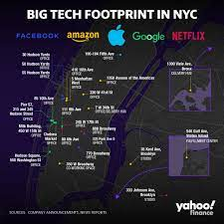
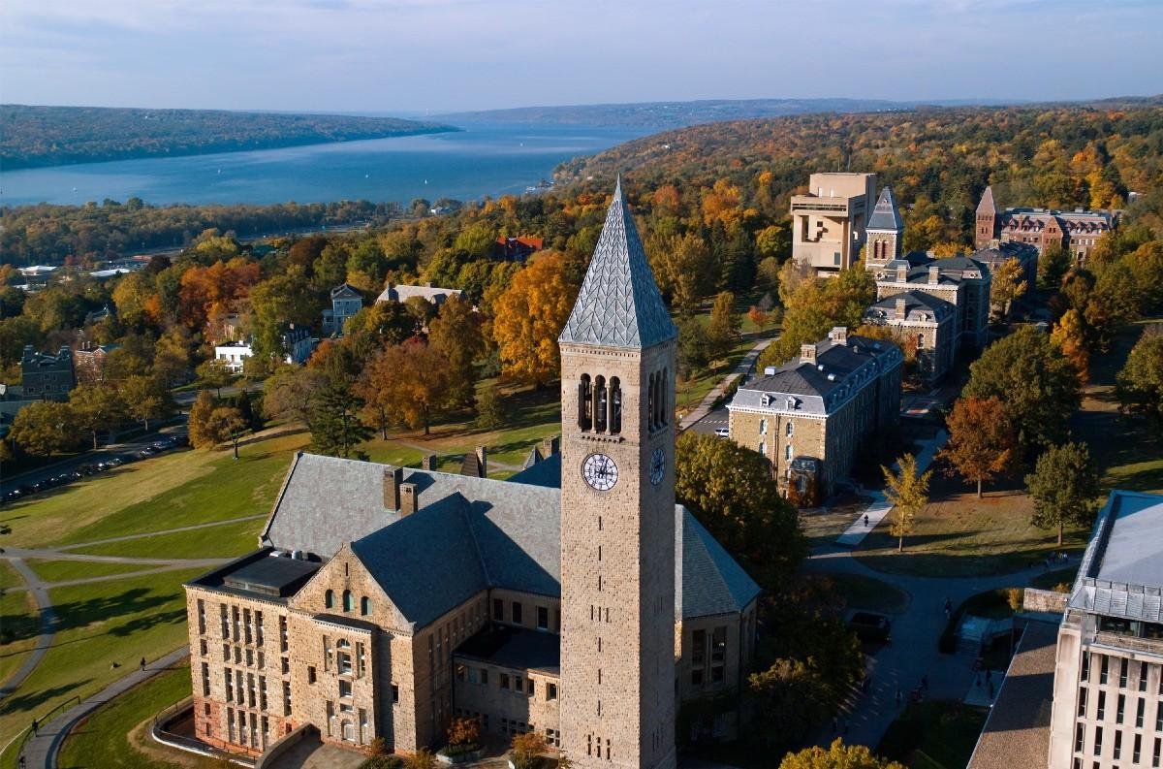
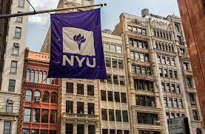


Companies and Colleges in NYC

Slide 3



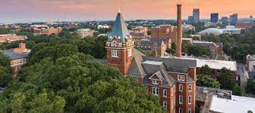
Companies and Colleges in Atlanta

Slide 4
Tough Decision
Both Atlanta and NYC have great colleges (NYU/Columbia/Cornell/Emory/Georgia Tech) and great job opportunities
This program aims to assist those deciding between these two great cities by looking at:
Crime Data
Weather using Location Data
Demographics Data
General Location Data

Slide 5
Tools Used
Python programming language
Jupyter Notebook
Pandas
Numpy
Folium
Foursquare API
Datasets from government servers

Slide 6
Methods used
Web scraping and Pandas functions to clean and prepare data
Clustering: a popular machine learning process
Folium to create detailed visuals
Mean function to determine demographic details

Slide 7
General Results and Insights
Weather: NYC is better for those who prefer colder weather, while Atlanta is generally more humid/warm.
Crime: NYC has a higher rate of crime per day/month/year but it has a much higher population density (32885.5 crimes occurred in NYC per year and 30076.45 crimes occurred in Atlanta per year)
As the rates are somewhat close, one could say that Atlanta is the slightly more dangerous city
General Location Data: Both cities have great venues (parks/bars/restaurants) and NYC is much more compact and populated than Atlanta

Slide 8
Demographics
Especially due to recent Asian American hate crimes, I focused on data related to Asians
Asians make up 0.06% of the population in NYC while they make up 2.5% of the population in Atlanta
Neither is a great statistic, but this shows that Atlanta is not as for Asians as it may seem

Slide 9
Conclusion
Using the program, hopefully one is able to compare and make a decision on whether they want to take the next step in life in Atlanta or NYC
Insights regarding weather/crime rates/demographics/general info.

Slide 10
THANK YOU!!!!

